Slide 1
Online Voting System
Data Structures FISAC

Slide 2
AIM

Slide 3
To create an online voting system using
Linked Lists.

Slide 4
Implementation of the Linear Data Structure-LINKED LISTS.• Multiple methods creation for various tasks under the project. In this system, authorized voters can give his\her votes online without going to any physical polling station.
OBJECTIVES

Slide 5
METHODOLOGY
Creation of singly linked list data structure using structures
Linked list is a linear data structure ,in which elements are not sorted over contiguous memory locations. The elements in linked list are linked using pointers .
Singly linked list is a unidirectional data structure,that is , it can be traversed in only one direction from head to last node.

Slide 6
A linked list is preferred over other structures is the that they are dynamic in nature and have faster deletion/insertion time.
Singly linked list is preferred when we need to save memory and searching is not required as pointer of single index is stored.
Linked lists are always better than Arrays as they do not lead to Memory Fragmentation.
In our Application ,we take input from the users to check they belong in the voter list and the candidate they vote and we display the winner.

Slide 7
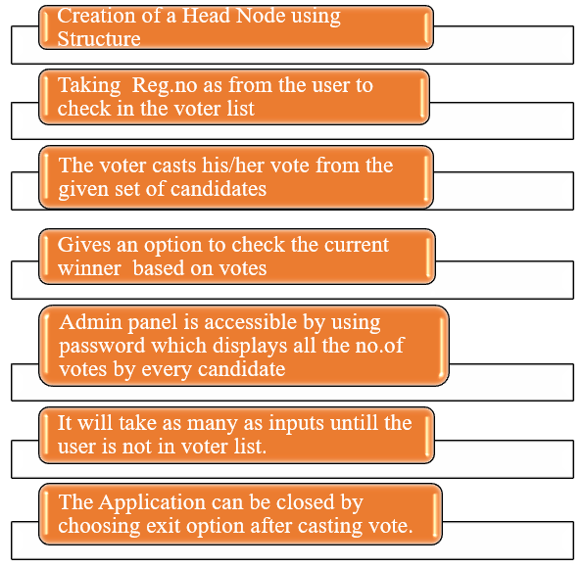
WORKFLOW

Slide 8
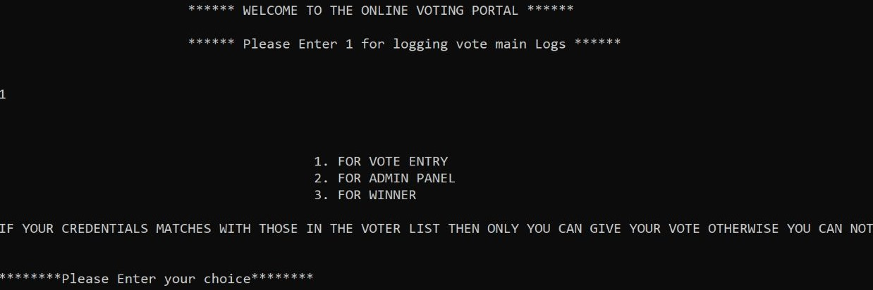
MAIN LOG

Slide 9
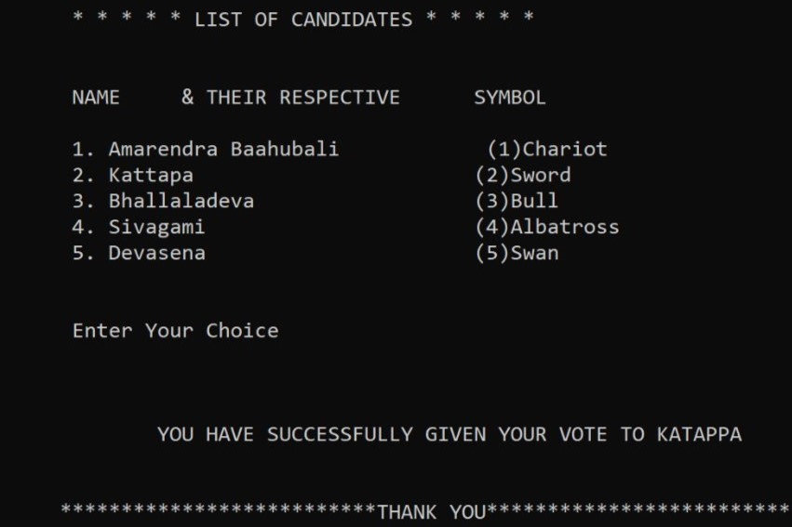
LIST OF CANDIDATES

Slide 10
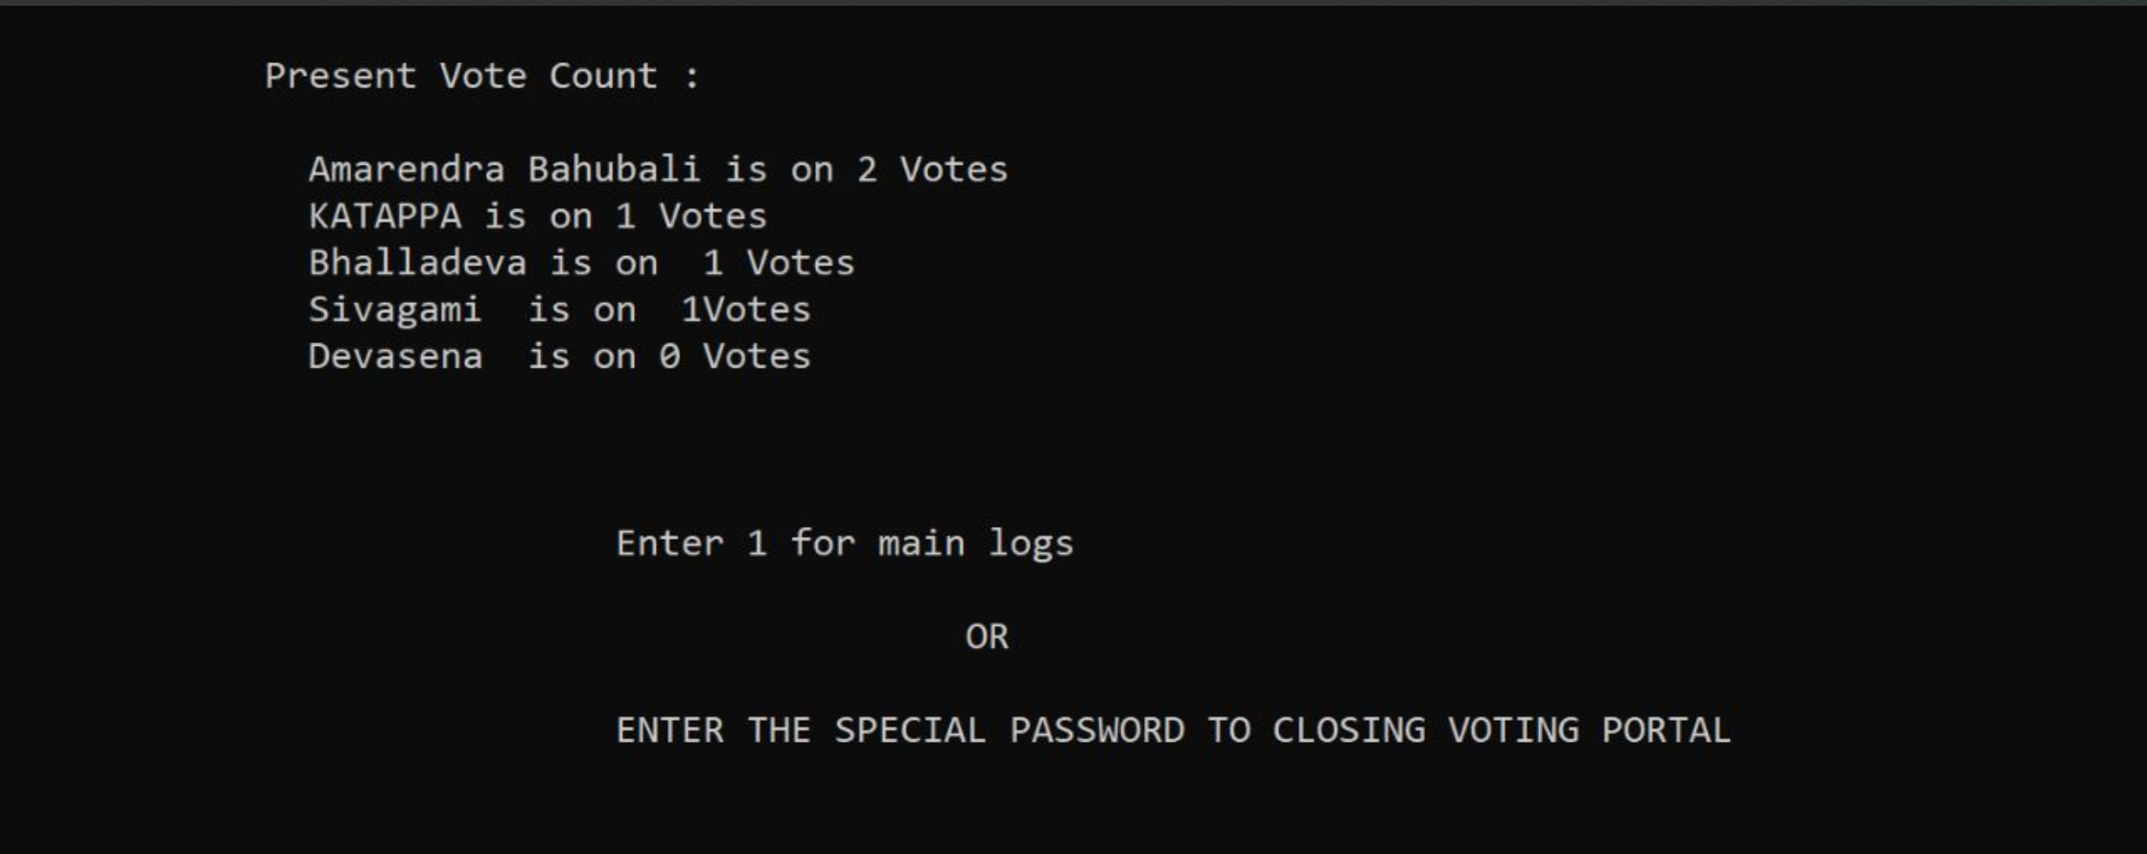
ADMIN PANEL
You can also access the voting count of all the candidates using the admin panel.

Slide 11
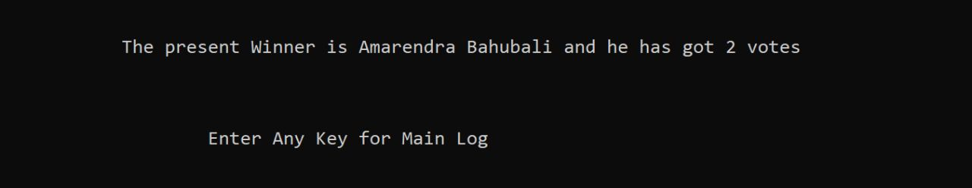
RESULT

Slide 12

REFERENCES
https://www.geeksforgeeks.org/category/linked-list/
https://stackoverflow.com/questions/1127396/struct-constructor-in-c
https://www.javatpoint.com/singly-linked-list

Slide 13
OUTCOMES
Practiced implementation of data structures
Singly linked lists are useful data structures, especially if you need to automatically allocate and de-allocate space in a list.
The code and complexity of these algorithms are bigger, but the trade-off is the ease of use.
Structures for data encapsulation.
Dynamic memory allocation using a new operator.

Slide 14
CONCLUSION
This project has been a very good assignment for me as I have learned the importance and implementation of linked lists in real-time applications.
I am very much thankful to our teachers for coming up with this kind of evaluation which involves individuals and also teamwork which makes the concept easy to grasp.

Slide 15
THANKS

Slide 16
TEAM MEMBERS
Saketh - 210968188
Anirudh - 210968052
Shreyas - 210968052
Santhosh – 210968090
Hari - 210968168

